Slide 1
BNY
Corporate Action Intelligence – Demo
Corporate Action Intelligence Team
Aesha Gandhi, Pranshul Bhatnagar, Alex Li, Kedar Vaidya, Aaron Jiang
Notes:
Thanks everyone for taking the time to meet with us.
We’re the Duke Corporate Action Intelligence capstone team, working with the BNY AI Hub to explore how AI can support corporate action processing.
Today we’ll briefly walk through:
how we’re approaching the project,
a demo of the workflow we’re envisioning,
and the evaluation work we’ve started.
Since you all work directly in corporate actions, we’d especially like to use this session to get your feedback on what feels realistic, useful, or missing from the workflow.
We’ll keep the technical detail fairly high level and focus more on the end-to-end use case.

Slide 2
CORPORATE ACTION INTELLIGENCE
Problem Statement & Solution Architecture
Large & Complex Documents
Relevant information is spread across lengthy filings, footnotes, and supporting exhibits.
Terms Change Over Time
Amendments dynamically revise transaction prices, key dates, and execution conditions.
Values Need Context
Key numerical values must be linked to the correct event, field, and verified source.
Covered Event Types: Mergers • Tender Offers • Exchange Offers • Rights Issues • Conversions
GOAL: Build a structured corporate-action dataset with traceable evidence for review and downstream automated processing.
input 01
Intake & Classification
timeline 02
Temporal Event Tracking
settings 03
Downstream Processing
verified_user 04
Audit & Exceptions
Notes:
Aesha
The core problem is that corporate-action information is often buried across long SEC filings, footnotes, and exhibits, so the important terms are not immediately accessible.
A second challenge is that the event changes over time. A later amendment may revise the offer price, expiration date, or other key conditions, so looking at one filing in isolation is not enough.
The third challenge is context: a number by itself is not useful unless we know what field it belongs to, which event it applies to, and where it came from.
So our goal is not just to extract values, but to build a structured corporate-action dataset where each field is tied back to traceable source evidence.
We are designing the framework to support several event types, but for the current demo and implementation work we are narrowing in on tender offers and mergers first.
The workflow at the bottom reflects the broader system: intake and classification, tracking changes over time, enabling downstream processing, and keeping an audit trail for exceptions and review.
Turn unstructured notices and filing documents into standardized, structured event fields.
Link multiple notices to the same event and identify what changed or superseded prior information.
Determine required actions such as calculations, notifications, and settlement-related operational steps.
Log decisions and evidence with full lineage; route ambiguous or high-risk cases to human review.

Slide 3
DATA PREPROCESSING & REASONING ARCHITECTURE
End-to-End Event Pipeline
01
02
03
04
SEC Metadata
Retrieve Filing Bundle
Normalize Documents
Extract Candidate Facts
Initial discovery and indexing via SEC EDGAR
Fetch complete source documents and exhibits from SEC EDGAR.
Convert raw HTML into clean, searchable plain text.
AI layer (GliNER) extracts structured candidate fact payloads.
05
06
07
08
Concise Representation
Reason / Verify / Resolve
Canonical Event State
BNY Client Notification
Compact event representation preserving evidence & context.
Process amendments and resolve canonical facts.
Single source of truth for verified corporate action facts.
Enriched internal context integrated for downstream alerts.
Notes:
Alex
This slide shows the full flow from raw SEC data to something that can actually be used downstream.
First, we use SEC metadata to identify relevant filings and then retrieve the complete filing bundle, including exhibits when needed.
Next, we normalize the documents so the filing text is in a cleaner, searchable format.
From there, we extract candidate facts such as prices, dates, parties, conditions, and other event-specific fields.
The next step is important: we do not treat every extracted value as automatically correct. We preserve evidence and context, then reason across multiple filings and amendments to resolve conflicts and determine the current value.
That gives us a canonical event state — essentially one current source of truth for the corporate action.
Once we have that structured event state, it can support downstream use cases such as internal alerts, client notifications, and other operational workflows.
The main idea is that the technical extraction is only one piece; the value comes from turning multiple documents into one reliable, current event representation.

Slide 4
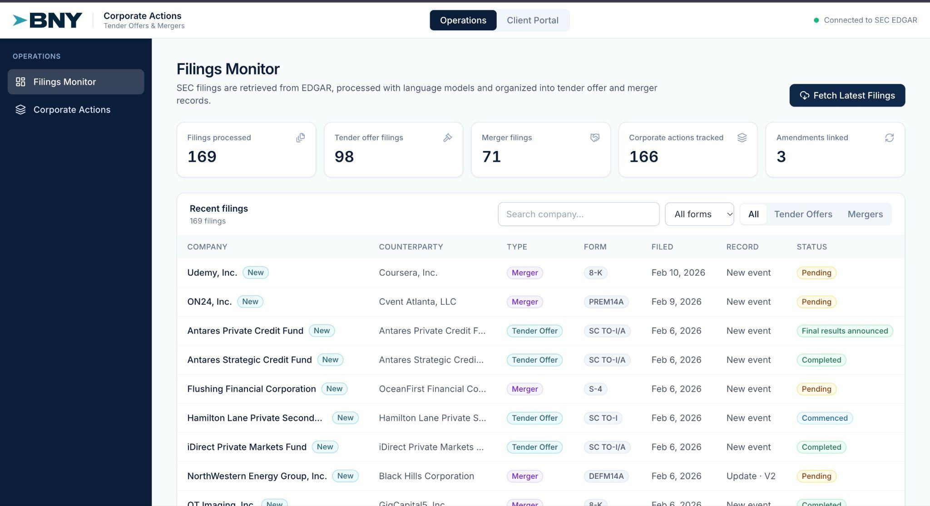
CORPORATE ACTION INTELLIGENCE
Filings Monitor Demo
Notes:
Pranshul

Slide 5

EVALUATION METHODOLOGY
Validation & Observability Framework
Human–Like Verification Approach
Evaluates extracted corporate action fields by leveraging LLMs to inspect the source document retrospectively, mimicking human domain audit rigor.
Mimics Expert Verification
Contextual Grounding Check
Replicates how domain experts verify structured facts against raw source text.
Confirms extracted values are explicitly supported by filing context.
Stream 1 · Baseline Benchmark (Pre-Deployment)
PIPELINE TESTING & ACCURACY BASELINING
STAGE 01
STAGE 02
STAGE 03
LLM GT Extraction
Run Pipeline
Benchmark Accuracy
LLM extracts golden facts from 1,000 reference corporate action filings.
Execute extraction pipeline against the identical 1,000-document set.
Compare pipeline outputs against LLM ground truth to score baseline performance.
Stream 2 · Continuous Observability (Post-Deployment)
CONTINUOUS PRODUCTION SAMPLING
STEP 01
STEP 02
STEP 03
Production Sampling
Backward LLM Search
Grounding & Drift Audit
Continuously sample subsets of live pipeline extractions across active filing streams.
Inspect raw filing text retrospectively to verify extracted facts against the source.
Detect hallucinations, verify grounding scores, and flag live production drift.
Notes:
Kedar
One challenge is that there is not a reliable labeled ground-truth dataset for all of the corporate actions we are working with.
We are therefore creating a standardized reference dataset from historical SEC filings.
We use the same schema and prompt across filings, run them through an LLM, normalize the outputs, and retain the supporting source passages.
Ambiguous examples can then be manually reviewed.
This gives us a scalable benchmark for measuring extraction accuracy, completeness, grounding, and amendment handling. 10_16 BNY Client Demo

Slide 6
Questions & Discussion Points
01
What downstream tasks are of interest to the BNY team or prioritized?
02
Which steps take the most time or require the most manual work?
03
What evidence would your team need to trust and use an extracted result?
04
Which extraction errors would have the greatest business impact?
05
Are there any gaps in our presented workflow and demo; what tasks or information can we address?
Notes:
Aaron
before we wrap up, we really appreciate for listening and we’d like to hear your feedback on how this project can best support BNY Team.
Priorities: “Which downstream tasks would you most like this data to support—for example, reviewing events or preparing client notifications?”
Manual effort: “In BNY current process, which steps take the most time? This would help us identify where our system could be most useful.”
Trustworthy: “What would you need to see to trust an extracted result? Would the original filing and supporting text be enough, or would you need additional checks?”
Error impact: “Which mistakes would be most concerning—for example, a wrong deadline, an incorrect price, or a missed event? This would help us prioritize our evaluation.”
Future steps: “Based on today’s demo, is there anything important missing, and what would you like us to focus on next?”

Slide 7

Questions?
We'd love to hear your feedback and answer any questions.
Thank you for your time and continued support with the BNY Corporate Actions Intelligence initiative.
Corporate Action Intelligence Team
Aesha Gandhi, Pranshul Bhatnagar, Alex Li, Kedar Vaidya, Aaron Jiang

Slide 8
Appendix

Slide 9

Structure-First Extraction Pipeline
Deterministic section routing and targeted local extraction using GLiNER and Regex
STEP 1
CLASSIFY
STEP 2
ROUTE
STEP 3
BOUND
STEP 4
EXTRACT
STEP 5
RECONCILE
1. Document Role
Tag file as cover, otp, sc_14d9, or amendment.
2. Structure Routing
Deterministically find candidate sections instead of full-doc search
3. Local Window
Isolate bounding spans around identified target headings
4. GLiNER / Regex Extraction
Targeted entity extraction on bounded spans
5. Source-Aware Reconciliation
Resolve field conflicts across the package
“Structure finds where to look. GLiNER finds the value.”
Notes:
Once we know which documents belong to the tender, the next question is how we actually extract information from them.
The key idea is to use a structure-first pipeline instead of running an extraction model over the entire document.
First, we classify the document role: is this a cover, an OTP, a 14D-9, or an amendment? That immediately tells us what kind of information we should expect.
Then, we use the document’s native structure to route to the right section. For example, Schedule TO filings have predictable Item headings, 14D-9 has a strong Item structure with Item 4 being particularly important, while OTPs are better navigated using their table of contents and narrative section headings.
After that, once we find the relevant section, we isolate a relatively small local context window around it. This reduces noise from documents that can be tens of thousands of words long.
Only then do we run GLiNER or regex-based extraction. Regex works well for strongly patterned values like CUSIPs, prices, or dates. GLiNER is more useful for variable semantic entities such as the offeror, target, security names, or recommendation language.
Finally, we reconcile conflicts using the source context. So if multiple documents mention the price, we prefer the OTP. For CUSIP, we prefer the Schedule TO cover. For board stance, we prefer 14D-9 Item 4. And if an amendment changes a value, the later amendment supersedes the earlier one.
So the architecture is really summarized by the line at the bottom: structure finds where to look, and GLiNER finds the value

